Slide 1
Lecture 17
The Chi-Square Distribution and The t Distribution, Their Relationship to The Normal Distribution and to Random Samples from A Normal Distribution
Confidence Intervals

Slide 2

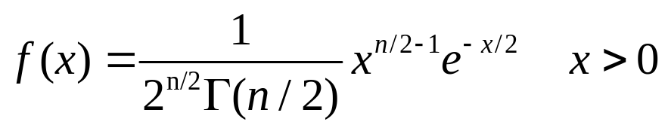
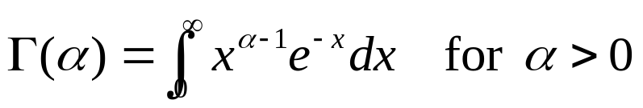

The Chi-square Distribution
For any given positive integer n, the distribution with n degrees of freedom.
where Γ is the gamma function defined as

Slide 3
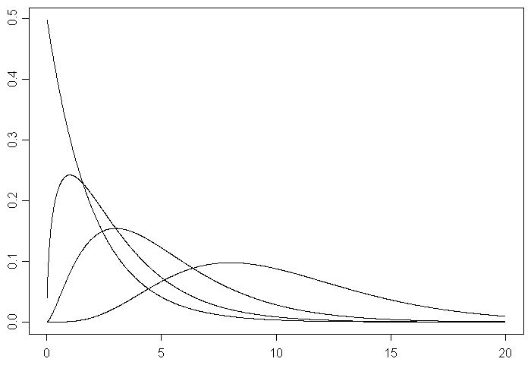
n=2
n=3
n=5
n=10

Slide 4

Theorem
If the random variables X1,…,Xn are independent and if Xi has a distribution with ni degrees of freedom (i=1,…,k), then the sum X1+…+Xn has a distribution with n1+…+nk degrees of freedom.

Slide 5

Relation of the distribution with the Normal Distribution
Theorem. If a random variable X has a standard normal distribution, then the random variable will have a distribution with one degree of freedom.

Slide 6

Theorem
If the random variables X1,…,Xn are i.i.d., and if each has a standard normal distribution, then the sum of squares
has a distribution with n degrees of freedom.

Slide 7


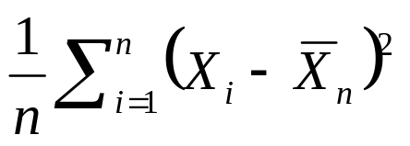
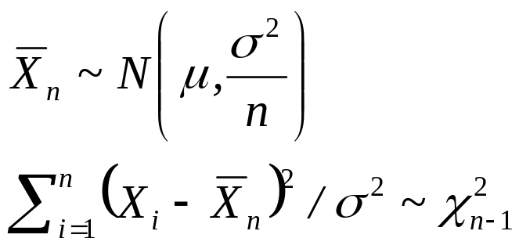
Joint Distribution of the Sample Mean and Sample Variances
Theorem. Suppose that X1,…,Xn form a random sample from a normal distribution with mean μ and variance . Then the sample mean and the sample variance
are independent random variables, and

Slide 8
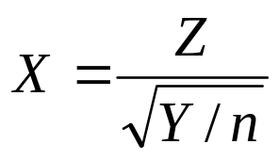
The t Distribution
Consider two independent random variables Y and Z, such that Z has a standard normal distribution and Y has a distribution with n degrees of freedom. Suppose a random variable X is defined by
Then the distribution of X is called the t distribution with n degrees of freedom.

Slide 9
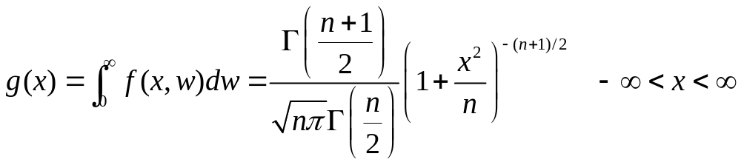

The p.d.f. and Relation to the Normal Distribution
When , g(x) converges to the p.d.f. φ(x) of the standard normal distribution for every value of x.
When n is large, the t distribution with n degrees of freedom can be approximated by the standard normal distribution.

Slide 10

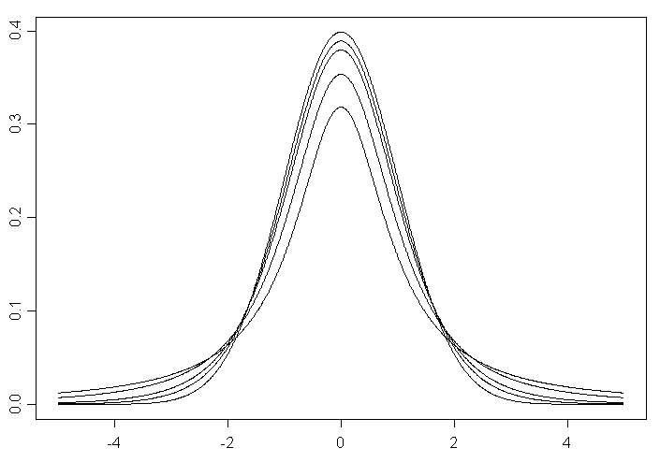
(normal)
n=10
n=5
n=2
n=1 (Cauchy)

Slide 11
Mean and Variance of the t Distribution
The mean does not exist when n=1. It exists and is equal to 0 for any value of n>1.
If X has a t distribution with n degrees of freedom (n>2), then Var(X)=n/(n-2).

Slide 12
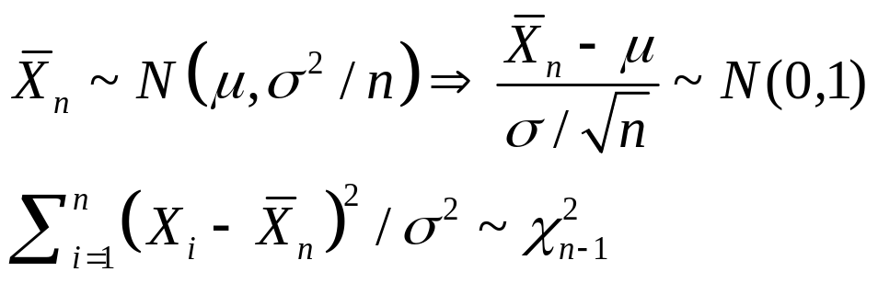
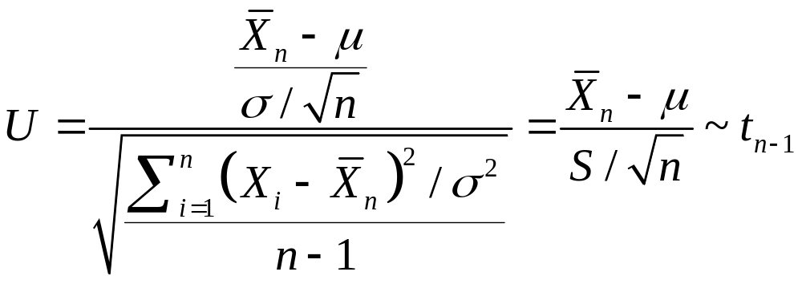
Relation to Random Samples from a Normal Distribution
Suppose that X1,…,Xn form a random sample from a normal distribution with mean μ and variance . Since
and they are independent of each other,

Slide 13
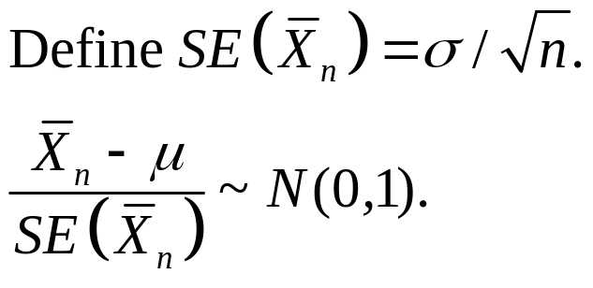

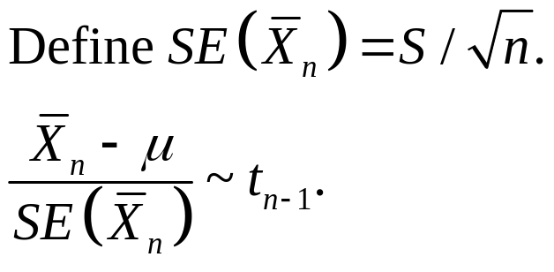
When the variance is known,
When it is unknown, we can replace by S,
They can be used to make statistical inference
about μ.

Slide 14
Example: Age of Insurance Policyholders
E.g. Estimation of the average age of life insurance policyholders
Ages of Life Insurance Policyholders from a Simple Random Sample of 36 Policyholders:
32 50 40 24 33 44 45 48 44 47 31 36
39 46 45 39 38 45 27 43 54 36 34 48
23 36 42 34 39 34 35 42 53 28 49 39
Assume that the ages follow a normal distribution.

Slide 15
Comparing the Following Statements
The average age of life insurance policyholders is estimated to be 39.5.
There is 90% confidence that the average age of life insurance policyholders is between 37.31 and 41.69.
Which statement gives you more information about the average age of life insurance policyholders?

Slide 16
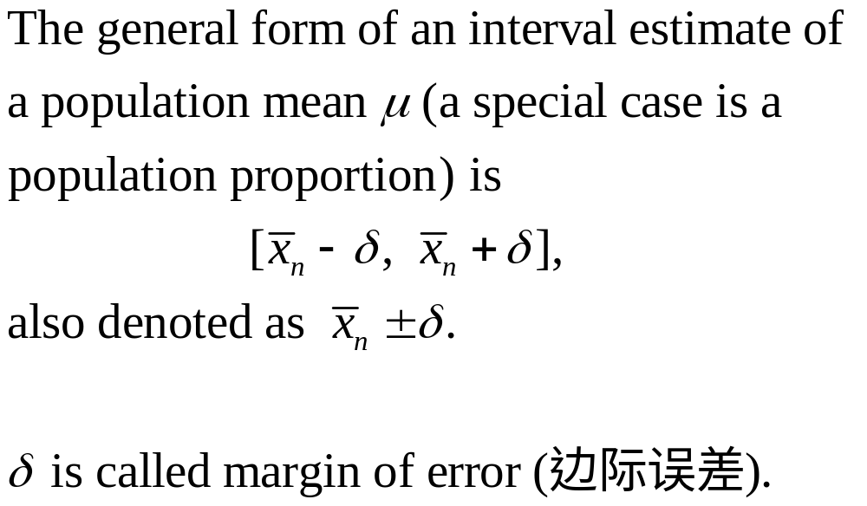
Statistical Inference Type 2:
Interval Estimation (区间估计)

Slide 17

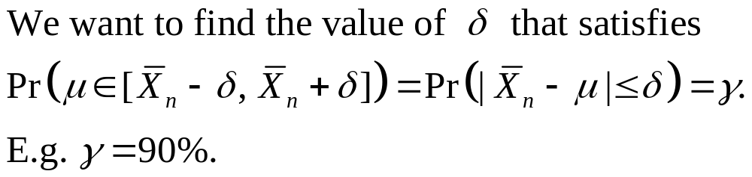
Requirement for

Slide 18
Confidence Intervals
Confidence Intervals for an Arbitrary Parameter θ
Suppose X1,…,Xn form a random sample from a distribution involving an unknown parameter θ.
Suppose that two statistics A(X1,…,Xn) and B(X1,…,Xn) can be found such that, regardless of the true value of θ,
where γ is a fixed probability.
If the observed values of A(X1,…,Xn) and B(X1,…,Xn) are a and b, then we say that the interval (a,b) is a confidence interval for θ with confidence coefficient γ, or θ lies in the interval (a,b) with confidence γ.

Slide 19

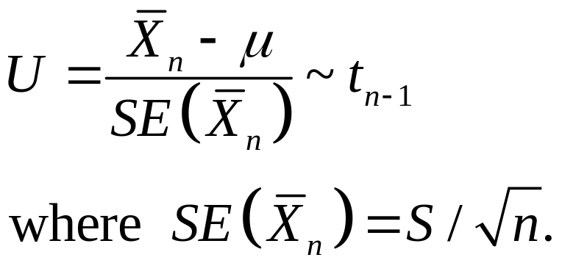
Confidence Intervals for the Mean of a Normal Distribution
Suppose that X1,…,Xn form a random sample from a normal distribution with unknown mean μ and unknown variance .

Slide 20
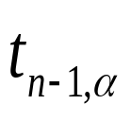
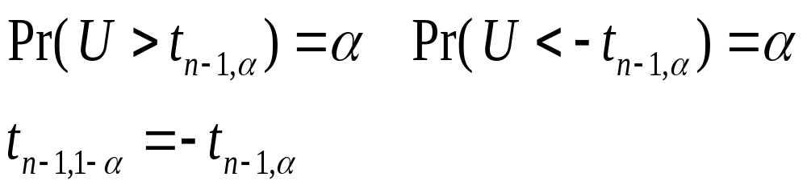

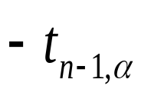


: the α upper-quantile of tn-1 distribution.

Slide 21
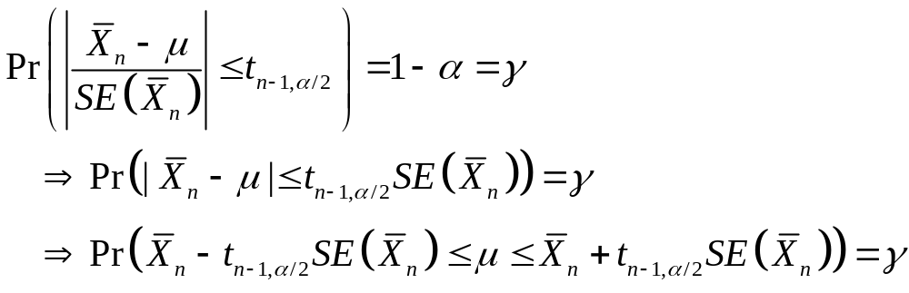
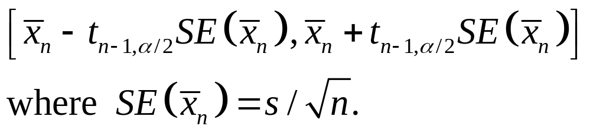
Usually the confidence coefficient γ =90%, 95%, 99%, etc. Let α=1-γ.
The confidence interval for μ is

Slide 22
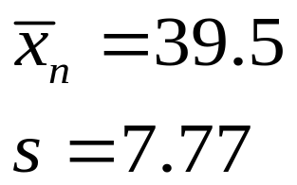
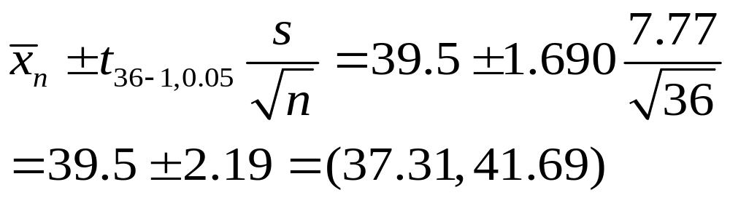
Example: Age of Insurance Policyholders
It is calculated that
So the 90% confidence interval estimate of the population mean is

Slide 23
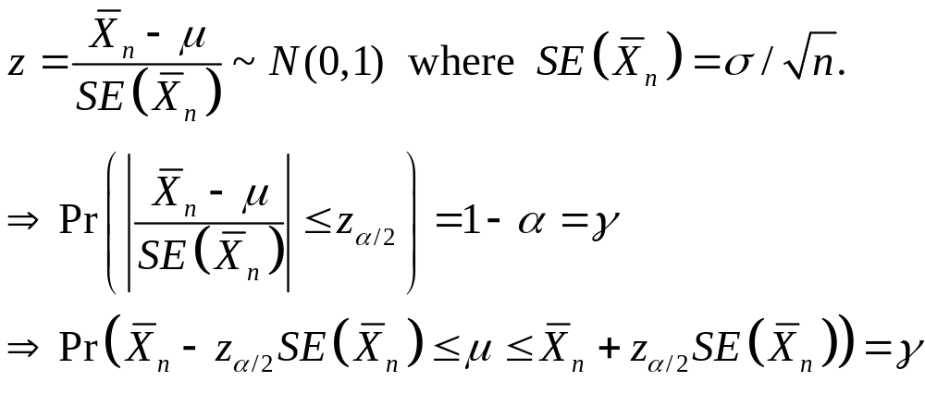
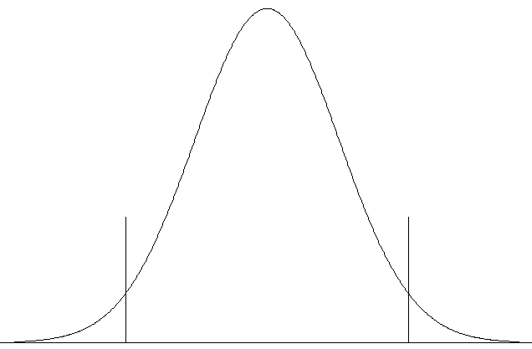




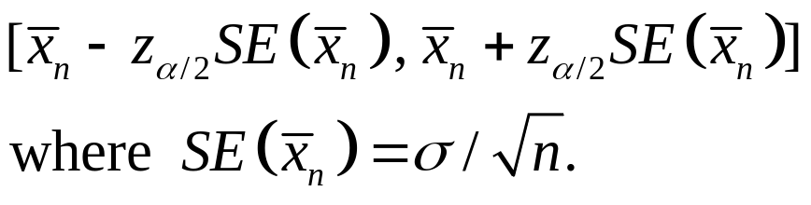
Confidence Intervals for the Mean of a Normal Distribution When the Variance is Known
Suppose that the observed values x1,…,xn come from a random sample from a normal distribution with unknown mean μ and known variance
So the confidence interval for μ is

Slide 24

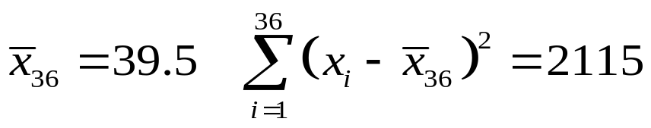
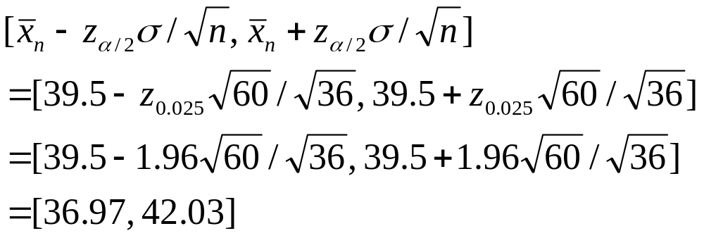
Example: Age of Insurance Policyholders:
95% Confidence Interval for μ When is known
It is calculated that
The confidence interval for μ is

Slide 25
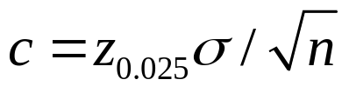



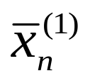


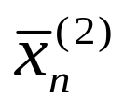



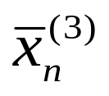

Interpretation of Confidence Intervals
Let
Consider intervals having the form
95% of all
values
inside purple band,
covers
inside purple band,
covers
outside purple band,
misses

Slide 26
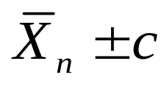
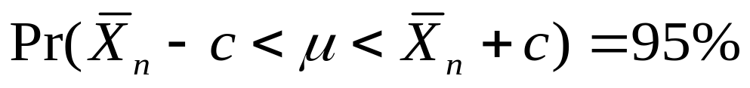
Before obtaining the observed values or over repeated sampling, there is probability 95% that the sample mean will lie in the purple band, so 95% of all intervals formed by will cover the population mean , or
It is not correct to state that μ lies in the confidence interval with probability 95%. We can only say that we are 95% confident.

